Slide 1
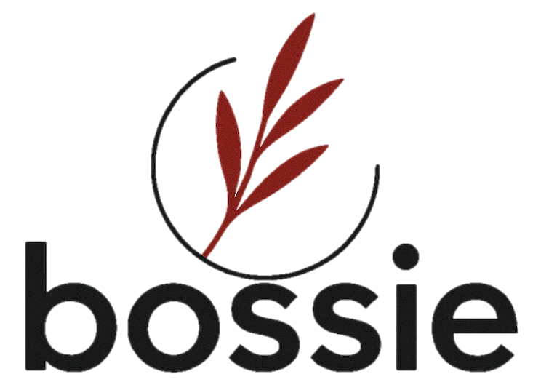



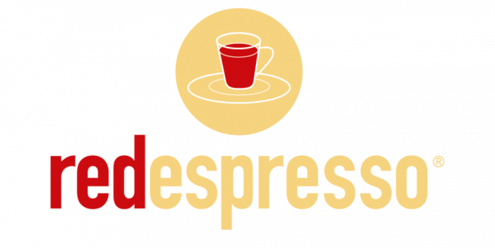
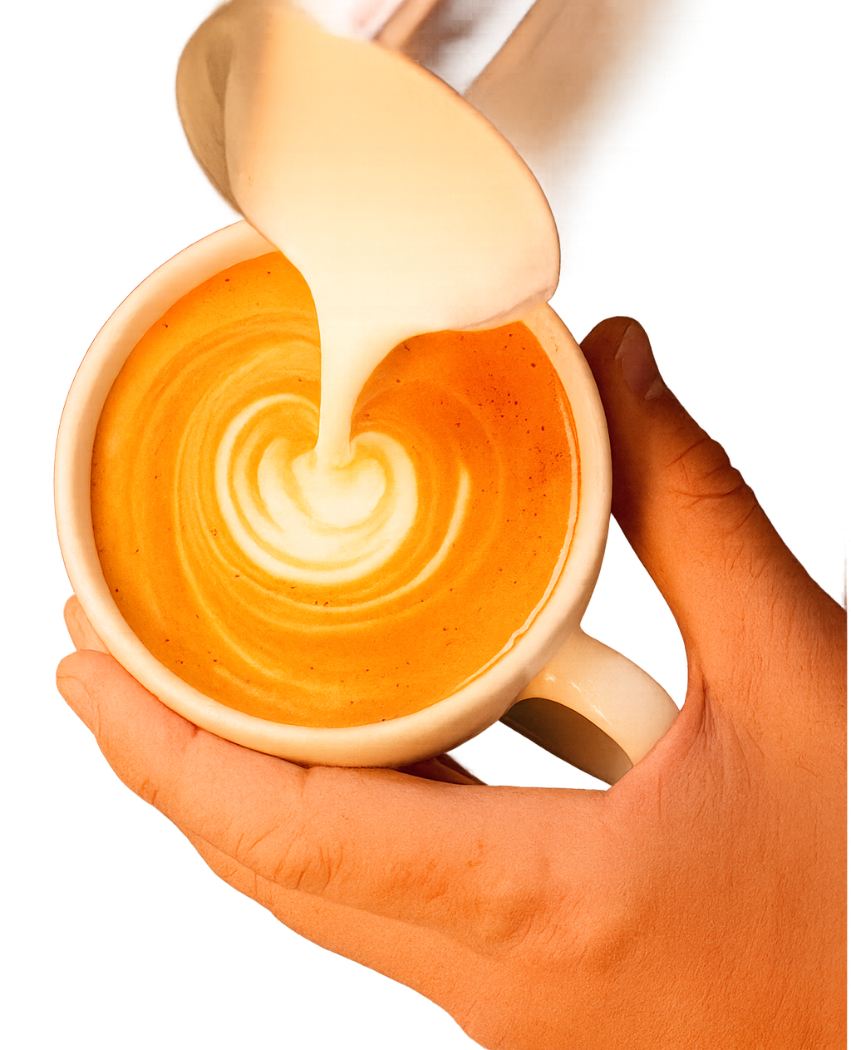

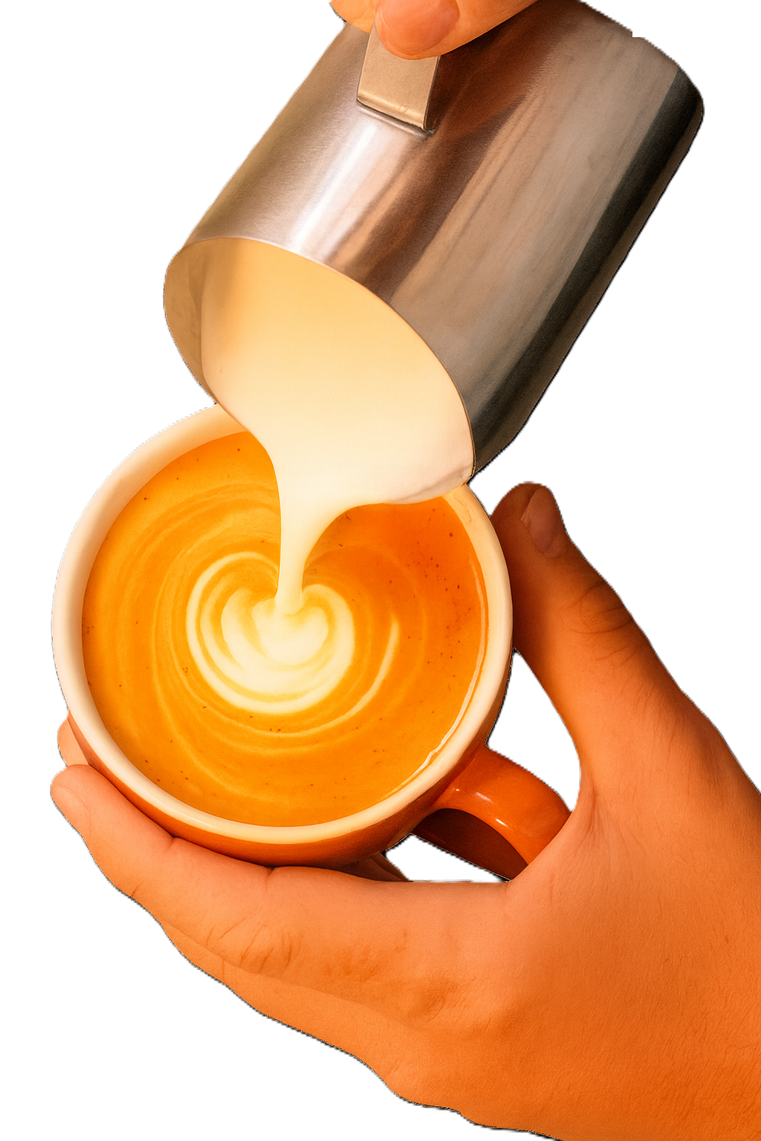
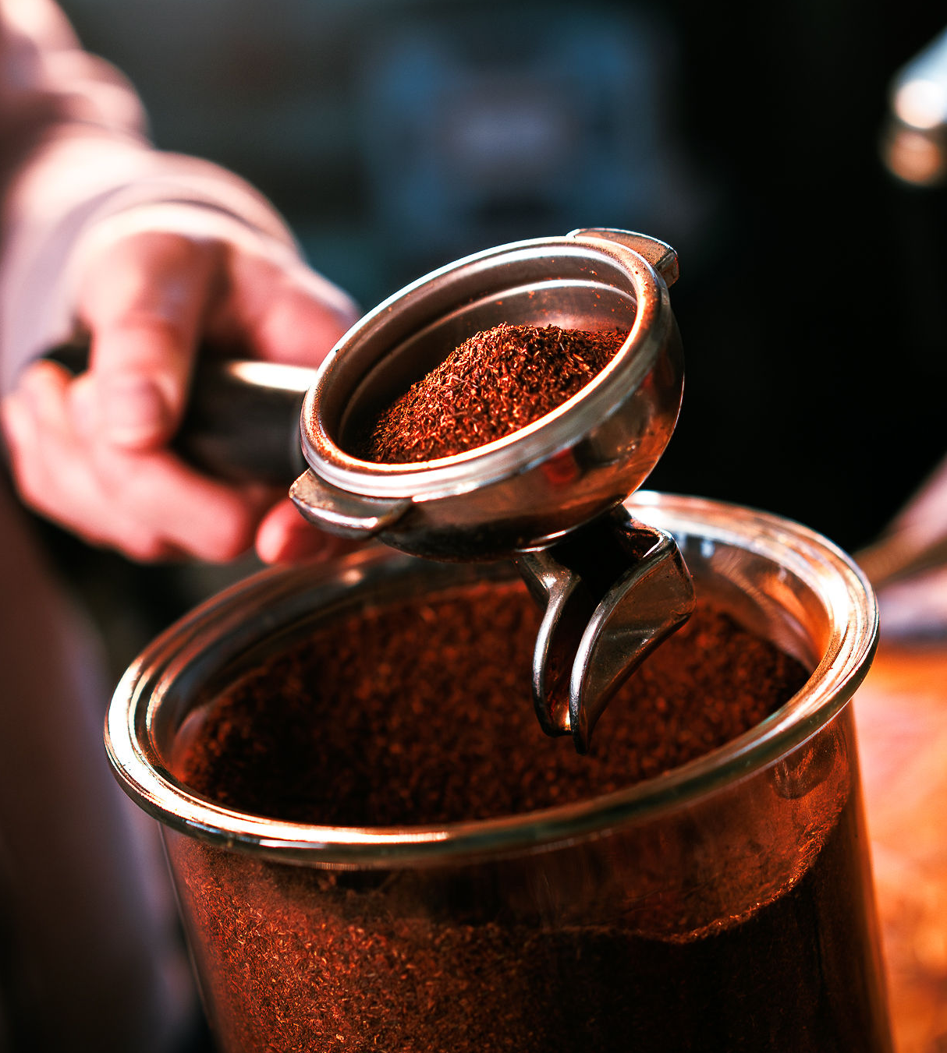
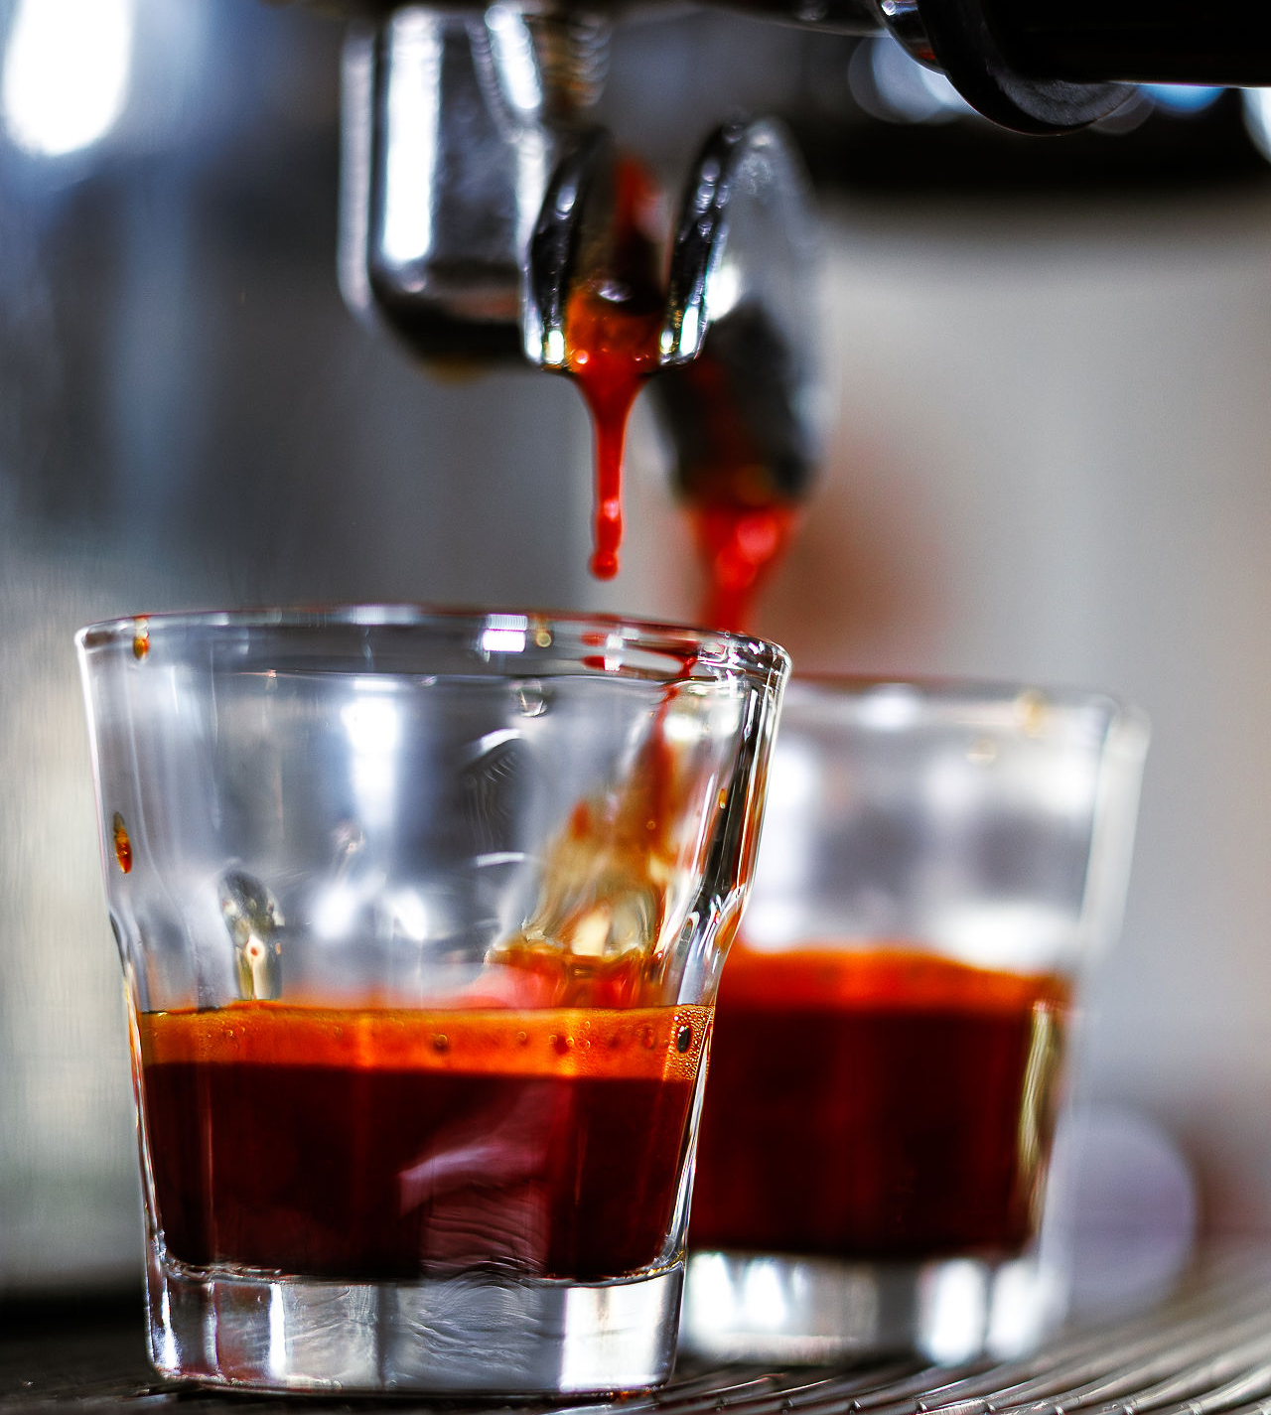
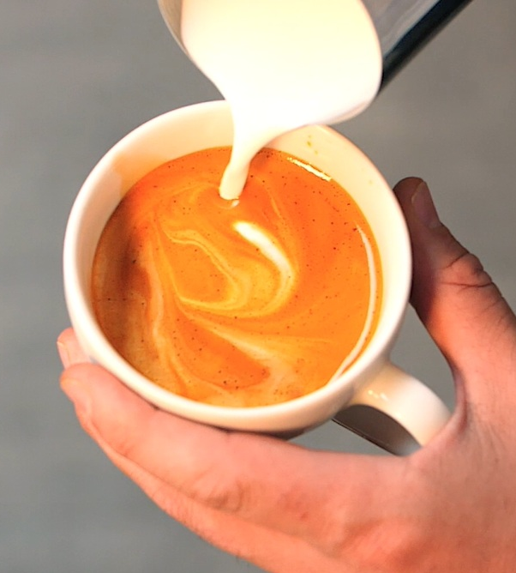

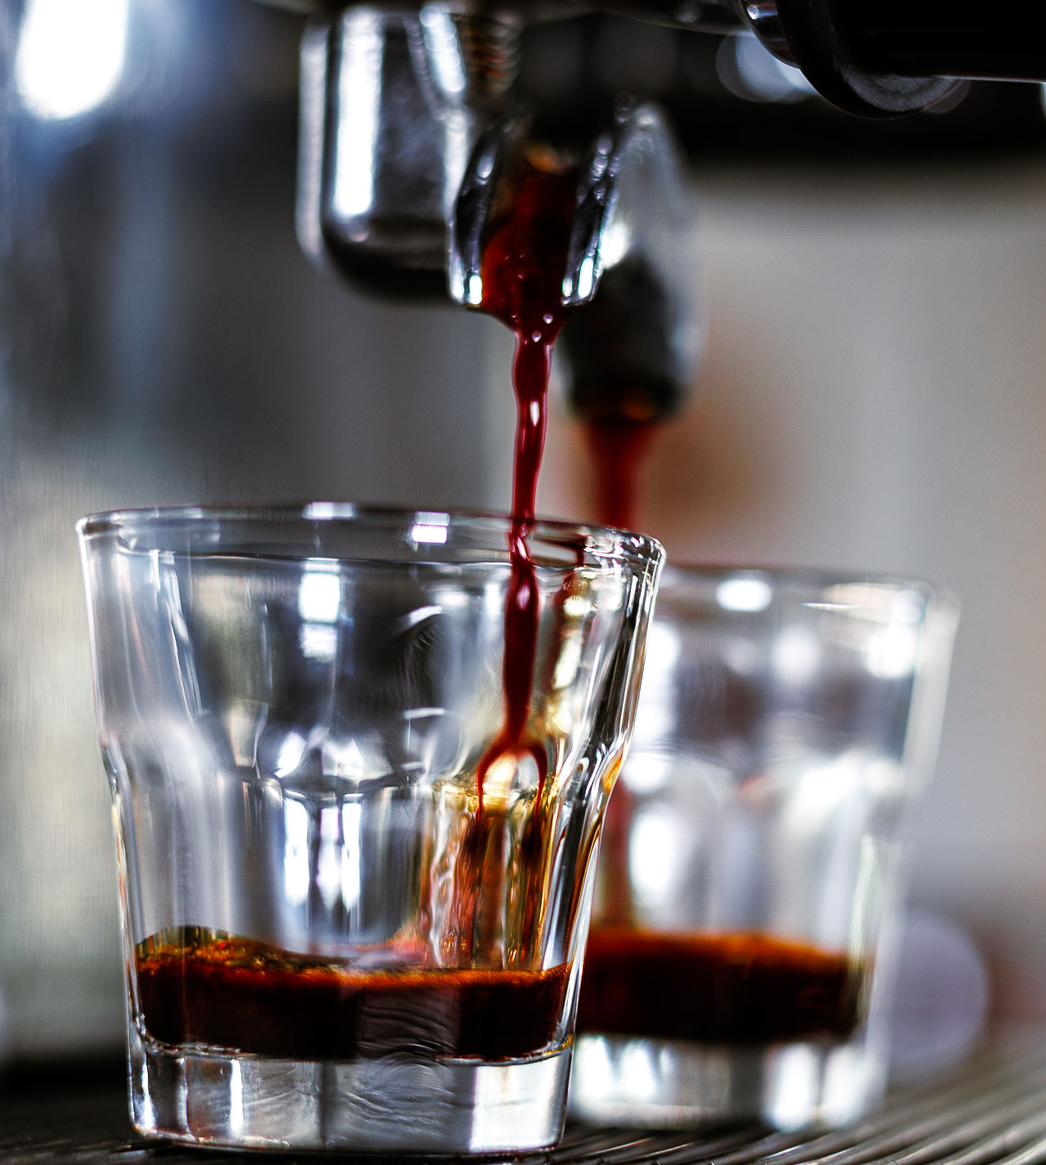
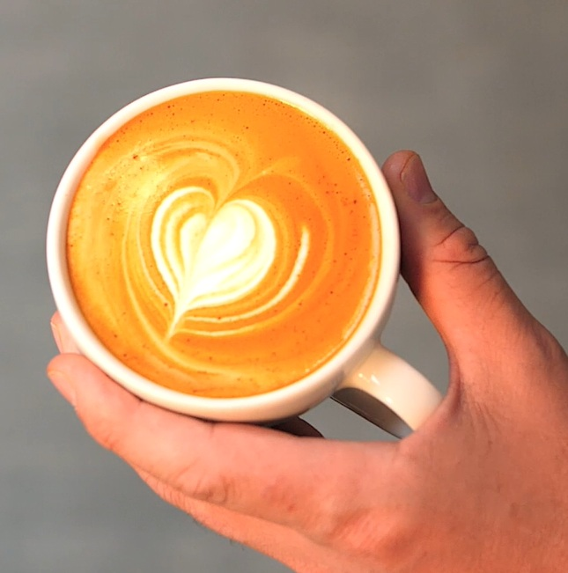
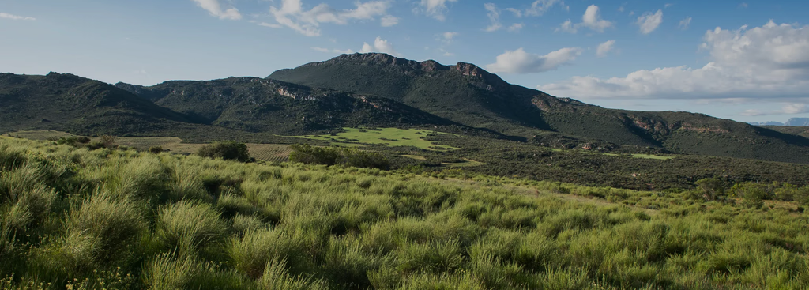
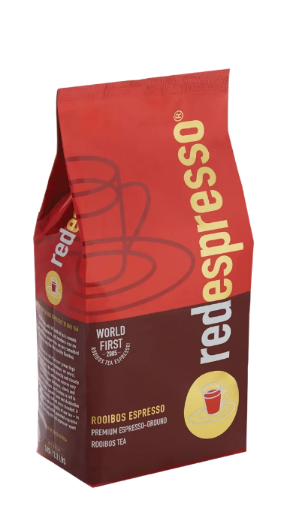
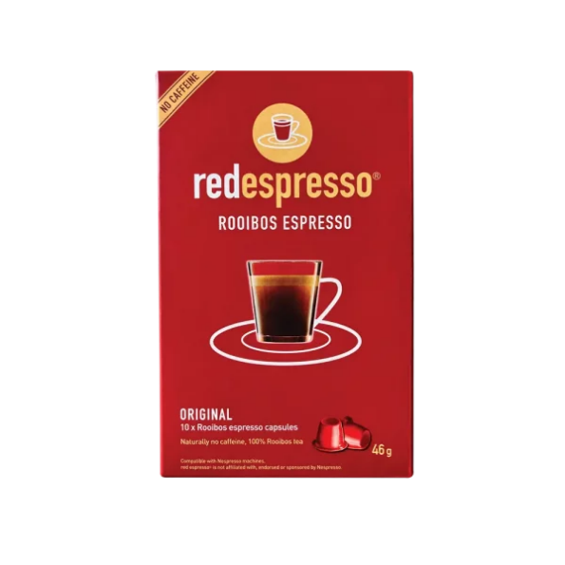
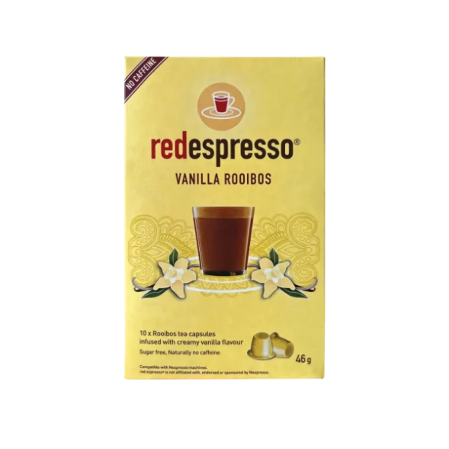
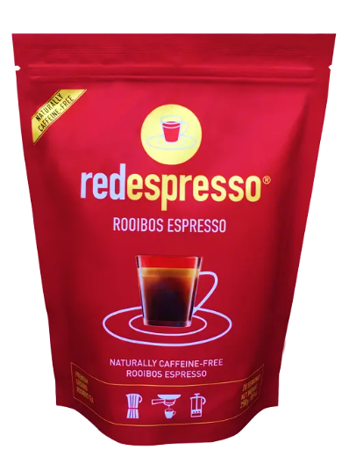
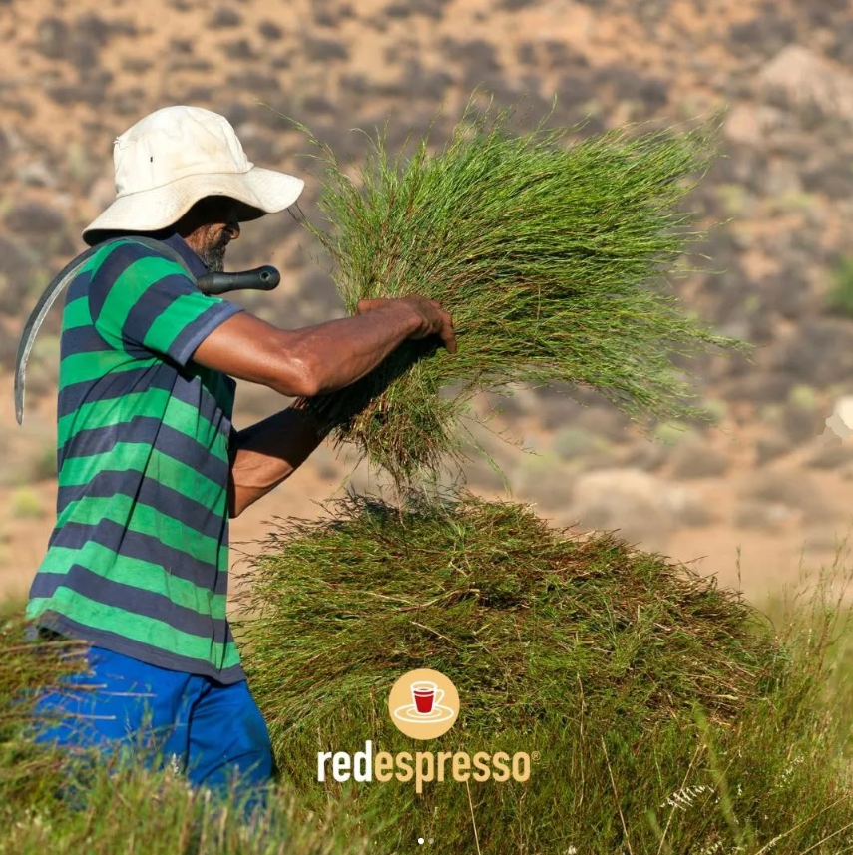
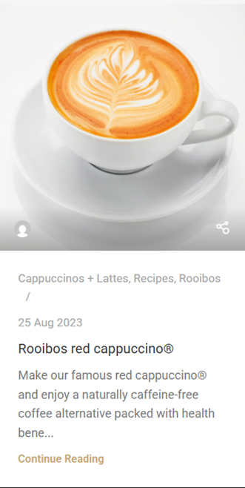
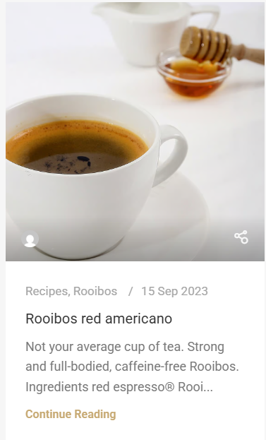


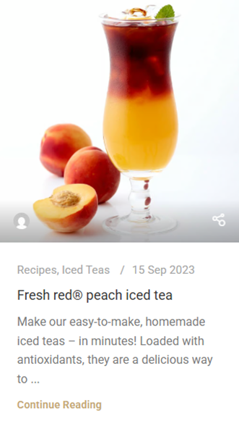
HOME
REZEPTEN
SHOP
ÜBER UNS
KONTAKT
Tea, that plays by the rules of coffee
red espresso®
the espresso made from rooibos tea. A true South African innovation that has enriched café culture since 2005.
Patented grinding technique Enables preparation on an espresso machine – as a strong, golden rooibos espresso.
Coffee-style drinks red cappuccino®, red latte® – and also perfect for smoothies and iced teas.
Naturally caffeine-free mild, earthy, and naturally sweet – rich in antioxidants and full of flavor.
Ideal for anyone who wants to avoid caffeine, doesn’t like coffee, or simply wants to try something new.
Single Origin aus den südafrikanischen Cederbergen –
direkt gehandelt, nachhaltig angebaut, ohne Pestizide, ohne Bewässerung
Unsere Produkte
Das Wundergewächs aus Südafrika
Rooibos, scientifically known as Aspalathus linearis, is a shrub-like legume that grows only in the Cederberg Mountains of South Africa’s Western Cape – and nowhere else in the world. It is naturally caffeine-free, rich in antioxidants, and known for its calming properties. Rooibos is especially loved for its mild, sweet, and earthy flavor.

Slide 2
HOME
REZEPTEN
SHOP
ÜBER UNS
KONTAKT
Tea, that plays by the rules of coffee
red espresso®
the espresso made from rooibos tea. A true South African innovation that has enriched café culture since 2005.
Patented grinding technique Enables preparation on an espresso machine – as a strong, golden rooibos espresso.
Coffee-style drinks red cappuccino®, red latte® – and also perfect for smoothies and iced teas.
Naturally caffeine-free mild, earthy, and naturally sweet – rich in antioxidants and full of flavor.
Ideal for anyone who wants to avoid caffeine, doesn’t like coffee, or simply wants to try something new.
Single origin from South Africa’s Cederberg Mountains directly traded, sustainably grown, pesticide-free, and cultivated without irrigation.
Unsere Produkte
Das Wundergewächs aus Südafrika
Rooibos, scientifically known as Aspalathus linearis, is a shrub-like legume that grows only in the Cederberg Mountains of South Africa’s Western Cape – and nowhere else in the world. It is naturally caffeine-free, rich in antioxidants, and known for its calming properties. Rooibos is especially loved for its mild, sweet, and earthy flavor.

